Slide 1
Currency Converter
Team members:
KAVALI SUDEEPTH 24KB1A05S1
LANKA ANGELIN BLESSY 24KB1A05W7
SHAIK SABIHA 24KB1A05JG

Slide 2
Introduction
Currency conversion is the process of changing money from one currency to another.
It uses exchange rates to determine the equivalent value.
This process is essential for international travel, global trade, and foreign investments.

Slide 3
Traditional Method of Currency Conversion
Manual Calculation using fixed exchange rates displayed at banks or exchange counters.
Paper-based conversion charts were used by travelers to estimate foreign costs.
Often required physical presence at a bank or money exchange center.
Limited accuracy and high chances of human error.

Slide 4
Drawbacks of Traditional Currency Conversion
Inaccurate Rates: Exchange rates were not updated in real time.
Time-Consuming: Required physical visits to banks or money changers.
Human Error: Manual calculations often led to mistakes.
Limited Access: Not available 24/7 or in remote locations.
Lack of Transparency: Hidden fees or unfavorable conversion margins.

Slide 5

Objective of the project
The objective of this project is to develop a simple yet efficient currency converter that can convert the value of one currency into another based on current exchange rates.
The converter will support multiple currencies and provide accurate and real-time conversion results.

Slide 6
System overview
This project is a Currency Converter that allows users to convert amounts between different currencies.
It uses an array to store currency exchange rates and a linked list to maintain a history of conversions.
The tool performs conversions using a simple mathematical formula based on stored rates.
Designed for simplicity, accuracy, and learning core programming concepts like data structures and algorithms.

Slide 7
Technologies and Tools
Data Structures
Array: Used to store currency rates for different currencies. Arrays are helpful when you need fast access to elements by index (e.g., looking up an exchange rate).
Linked List: Used to maintain a history of conversions. A linked list allows efficient insertion and removal of historical data (when conversions happen or when you clear history)

Slide 8
Currency Converter – Algorithm
STEP 1: Start
STEP 2: Initialize currency data and conversion history.
STEP 3: Display Menu with options: Convert, View History, Exit
STEP 4:If Convert selected:
Input source and target currencies
Input amount
Look up exchange rates
Calculate converted value
Display result
Save conversion to history
STEP 5: If View History selected:
Show all past conversions
STEP 6: If Exit selected:
End program
STEP 7: Repeat until Exit is chosen
STEP 8: End

Slide 9
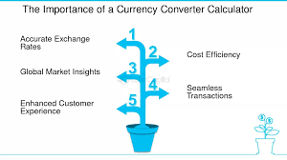
Importance of Currency Conversion
Facilitates international trade and tourism.
Allows businesses to operate across borders.
Enables consumers to compare prices globally.

Slide 10
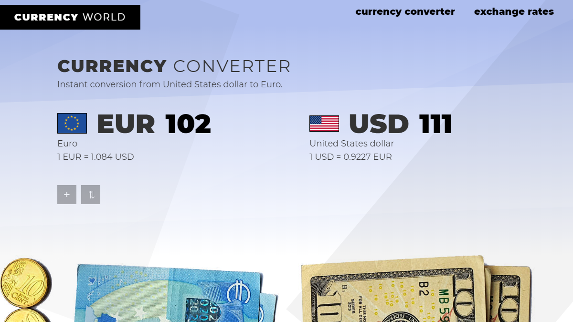
Example Conversion
Convert 100 USD to EUR:
Exchange Rate: 1 USD = 0.90 EUR
Result: 100 × 0.90 = 90 EUR

Slide 11
Advantages of Currency Converter
Time-Saving: Instant conversion without manual calculations.
Accurate Results: Minimizes human error using programmed logic and live rates.
User-Friendly: Simple interface for quick access to exchange information.
Multi-Currency Support: Convert between many currencies in one place.
Conversion History: Keeps track of past conversions for easy reference.

Slide 12
Limitations of Currency Converter
Dependency on Internet: Real-time rates require a stable internet connection.
No Offline Rates Update: Without internet, rates may be outdated or unavailable.
Limited Currency Support: Some converters may not support all world currencies.
Floating Exchange Rates: Rates fluctuate constantly; even real-time rates may quickly become outdated.
No Transaction Fees Considered: Conversion doesn’t include fees charged by banks or money exchangers.

Slide 13

Applications of Currency Converters
Travel: Helps with currency conversion for tourists.
E-commerce: Converts prices for online shopping.
Finance: Assists in foreign exchange and budgeting.
Business: Useful for international transactions.
Education: Demonstrates programming concepts.

Slide 14
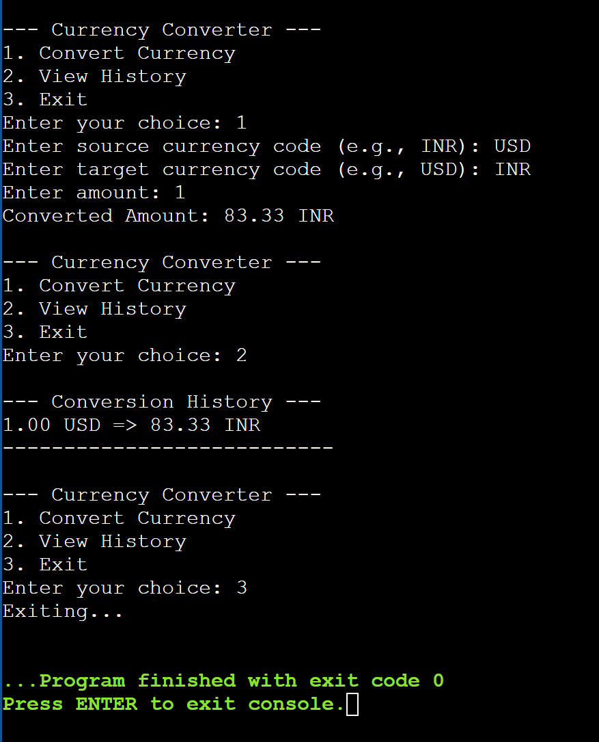
output

Slide 15
Conclusion
A currency converter provides fast and accurate conversions.
Arrays ensure quick rate access; linked lists store history efficiently.
Useful for travel, business, and financial planning.
Can be improved with real-time updates and more features.

Slide 16


